Slide 1
Introduction to Programming
Session 11
Search – Sort Algorithms

Slide 2
Objectives
Search Algorithms
  Linear search
  Binary search
Sort Algorithms
  Selection sort
  Insertion sort
  Bubble sort

Slide 3
Introduction to searching
Searching is one of the most common actions performed in regular business applications. This involves fetching some data stored in data structures like Arrays, List, Map, etc. More often than not, this search operation determines the responsiveness of the application for the end-user.
In this article, let's take a look at some of the searching strategies that can be used to cater to different scenarios.
To illustrate the concept of algorithm efficiency, we consider two common algorithms for searching array: linear & binary search.

Slide 4
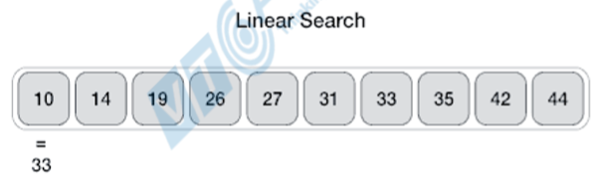
Linear search
Linear or Sequential Search is the simplest of search algorithms. While it most certainly is the simplest, it's most definitely not the most common, due to its inefficiency. It's a brute-force algorithm. Very rarely is it used in production, and in most cases, it's outperformed by other algorithms.
Linear Search has no pre-requisites for the state of the underlying data structure.
Linear Search involves sequential searching for an element in the given data structure until either the element is found or the end of the structure is reached.
If the element is found, we usually just return its position in the data structure. If not, we usually return -1.

Slide 5
Linear search
Example
=========================
  Input : arr[] = {10, 20, 80, 30, 60, 50,
  110, 100, 130, 170}
  x = 110;
  Output : 6
  Element x is present at index 6
=========================
  Input : arr[] = {10, 20, 80, 30, 60, 50,
  110, 100, 130, 170}
  x = 175;
  Output : -1
  Element x is not present in arr[].

Slide 6
Linear search
public class LinearSearchExample{
public static int linearSearch(int[] arr, int key){
for(int i=0;i<arr.length;i++){
if(arr[i] == key){
return i;
}
}
return -1;
}
public static void main(String a[]){
int[] a1= {10,20,30,50,70,90};
int key = 50;
int pos = linearSearch(a1, key);
if (pos>=0)
System.out.println(key+" is found at index: "+pos);
else
System.out.println(key+" not found");
}
}
Output:
50 is found at index: 3

Slide 7
Linear search
import java.util.Scanner;
class LinearSearchExample2 {
public static void main(String args[]) {
int c, n, search, array[];
Scanner in = new Scanner(System.in);
System.out.println("Enter number of elements: "); n = in.nextInt(); array = new int[n];
System.out.println("Enter those " + n + " elements: ");
for (c = 0; c < n; c++)
array[c] = in.nextInt();
System.out.println("Enter value to find: "); search = in.nextInt();
for (c = 0; c < n; c++) {
if (array[c] == search) { /* Searching element is present */
System.out.println(search + " is present at location " + (c + 1) + ".");
break;
}
}
if (c == n) /* Element to search isn't present */
System.out.println(search + " isn't present in array.");
}
}

Slide 8
Binary search
Binary or Logarithmic Search is one of the most commonly used search algorithms primarily due to its quick search time, it requires the data set to be sorted beforehand.
Binary searching works by comparing an input value to the middle element of the array:
  When the element being compared equals the input, the search stops and typically returns the position of the element.
  If the element is not equal to the input, then a comparison is made to determine whether the input is less than or greater than the element. Depending on which it is, the algorithm then starts over, but only searching the top or a bottom subset of the array's elements.
  If the input is not located within the array, the algorithm will usually output a unique value (-1) indicating this.
Binary search algorithms typically halve the number of items to check with each successive iteration, thus locating the given item (or determining its absence) in logarithmic time.

Slide 9
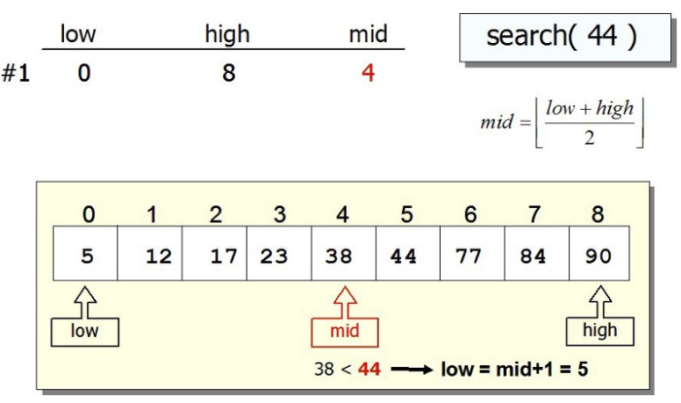
Binary search

Slide 10
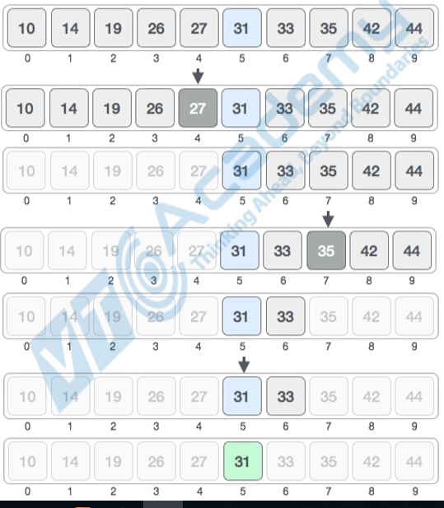
Binary search

Slide 11
Binary search
class BinarySearchExample{
public static int binarySearch(int arr[], int first, int last, int key){
int mid = (first + last)/2;
while( first <= last ){
if ( arr[mid] < key ) first = mid + 1;
else if ( arr[mid] == key ) return mid;
else last = mid - 1;
mid = (first + last)/2;
}
if ( first > last ) return -1;
}
public static void main(String args[]){
int arr[] = {10,20,30,40,50};
int key = 30;
int last=arr.length-1;
int pos = binarySearch(arr,0,last,key);
if(pos>=0) System.out.println("Element is found at index: " + mid);
else System.out.println("Element is not found!");
}
}
Output:
Element is found at index: 2

Slide 12
Binary search example using Recursion
class BinarySearchExample1{
public static int binarySearch(int arr[], int first, int last, int key){
if (last>=first){
int mid = first + (last - first)/2;
if (arr[mid] == key)
return mid;
else if (arr[mid] > key) return binarySearch(arr, first, mid-1, key);//search in left subarray
else return binarySearch(arr, mid+1, last, key);//search in right subarray
}
return -1;
}
public static void main(String args[]){
int arr[] = {10,20,30,40,50};
int key = 30;
int last=arr.length-1;
int pos = binarySearch(arr,0,last,key);
if(pos>=0) System.out.println("Element is found at index: " + mid);
else System.out.println("Element is not found!");
}
}
Output:
Element is found at index: 2

Slide 13
Binary search example using Arrays.binarySearch()
import java.util.Arrays;
class BinarySearchExample2{
public static void main(String args[]){
int arr[] = {10,20,30,40,50};
int key = 30;
int result = Arrays.binarySearch(arr,key);
if (result < 0)
System.out.println("Element is not found!");
else
System.out.println("Element is found at index: "+result);
}
}
Output:
Element is found at index: 2

Slide 14
Introduction to sorting
Sorting data means arranging it in a certain order, often in an array-like data structure.
You can use various ordering criteria, common ones being sorting numbers from least to greatest or vice-versa, or sorting strings lexicographically.
There are various sorting algorithms, and they're not all equally efficient.
The list of algorithms you'll learn here is by no means exhaustive, but we have compiled some of the most common and most efficient ones to help you get started:
  Bubble Sort
  Insertion Sort
  Selection Sort

Slide 15
Bubble sort
Bubble sort works by swapping adjacent elements if they're not in the desired order. This process repeats from the beginning of the array until all elements are in order.
We know that all elements are in order when we manage to do the whole iteration without swapping at all - then all elements we compared were in the desired order with their adjacent elements, and by extension, the whole array.
The worst case time complexity would be O(n^2) with n is size of array.

Slide 16
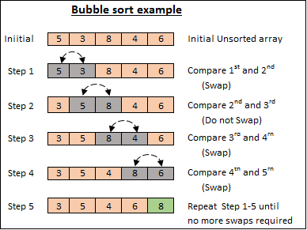
Bubble sort

Slide 17
Bubble sort example
public class BubbleSortExample {
static void bubbleSort(int[] arr) {
int n = arr.length;
int temp = 0;
for(int i=0; i < n; i++){
for(int j=1; j < (n-i); j++){
if(arr[j-1] > arr[j]){
//swap elements
temp = arr[j-1];
arr[j-1] = arr[j];
arr[j] = temp;
}
}
}
}
public static void main(String[] args) {
int arr[] ={3,60,35,2,45,320,5};
System.out.println("Array Before Bubble Sort");
for(int i=0; i < arr.length; i++){
System.out.print(arr[i] + " ");
}
System.out.println();
bubbleSort(arr);//sorting array elements using bubble sort
System.out.println("Array After Bubble Sort");
for(int i=0; i < arr.length; i++){
System.out.print(arr[i] + " ");
}
}
}
Output:
Array Before Bubble Sort
3 60 35 2 45 320 5
Array After Bubble Sort
2 3 5 35 45 60 320

Slide 18
Insertion sort
The idea behind Insertion Sort is dividing the array into the sorted and unsorted subarrays.
The sorted part is of length 1 at the beginning and is corresponding to the first (left-most) element in the array. We iterate through the array and during each iteration, we expand the sorted portion of the array by one element.
Upon expanding, we place the new element into its proper place within the sorted subarray. We do this by shifting all of the elements to the right until we encounter the first element we don't have to shift.
This is because in each iteration, we'll have to move the whole sorted list by one, which is O(n). We have to do this for each element in every array, which means it's going to be bounded by O(n^2).

Slide 19

Insertion sort

Slide 20
Bubble sort example
public class InsertionSortExample {
public static void insertionSort(int array[]) {
int n = array.length;
for (int j = 1; j < n; j++) {
int key = array[j];
int i = j-1;
while ( (i > -1) && ( array [i] > key ) ) {
array [i+1] = array [i];
i--;
}
array[i+1] = key;
}
}
public static void main(String a[]){
int[] arr1 = {9,14,3,2,43,11,58,22};
System.out.println("Before Insertion Sort");
for(int i:arr1){
System.out.print(i+" ");
}
System.out.println();
insertionSort(arr1);//sorting array using insertion sort
System.out.println("After Insertion Sort");
for(int i:arr1){
System.out.print(i+" ");
}
}
}
Output:
Before Insertion Sort
9 14 3 2 43 11 58 22
After Insertion Sort
2 3 9 11 14 22 43 58

Slide 21
Selection sort
Selection Sort also divides the array into a sorted and unsorted subarray. Though, this time, the sorted subarray is formed by inserting the minimum element of the unsorted subarray at the end of the sorted array.
Finding the minimum is O(n) for the length of array because we have to check all of the elements. We have to find the minimum for each element of the array, making the whole process bounded by O(n^2).

Slide 22
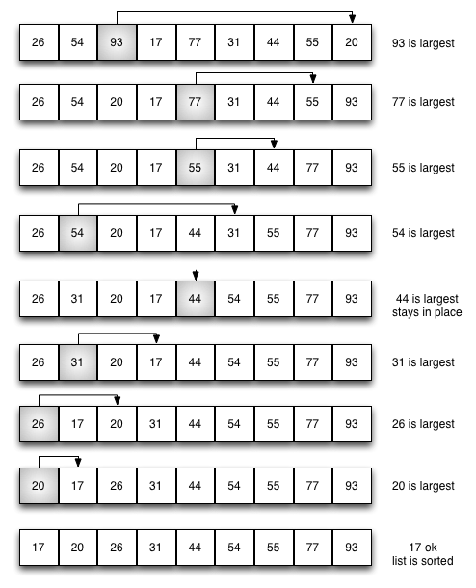
Selection sort

Slide 23
Selection sort example
public class SelectionSortExample {
public static void selectionSort(int[] arr){
for (int i = 0; i < arr.length - 1; i++)
{
int index = i;
for (int j = i + 1; j < arr.length; j++){
if (arr[j] < arr[index]){
index = j;//searching for lowest index
}
}
int smallerNumber = arr[index];
arr[index] = arr[i];
arr[i] = smallerNumber;
}
}
public static void main(String a[]){
int[] arr1 = {9,14,3,2,43,11,58,22};
System.out.println("Before Selection Sort");
for(int i:arr1){
System.out.print(i+" ");
}
System.out.println();
selectionSort(arr1);//sorting array using selection sort
System.out.println("After Selection Sort");
for(int i:arr1){
System.out.print(i+" ");
}
}
}
Output:
Before Selection Sort
9 14 3 2 43 11 58 22
After Selection Sort
2 3 9 11 14 22 43 58

Slide 24
References
https://www.javatpoint.com/linear-search-in-java
https://www.geeksforgeeks.org/java-program-for-linear-search/
https://www.javatpoint.com/binary-search-in-java
https://www.geeksforgeeks.org/binary-search-in-java/
https://stackabuse.com/sorting-algorithms-in-java/
https://stackabuse.com/search-algorithms-in-java/
https://www.geeksforgeeks.org/sorting-algorithms/
http://www.javawithus.com/tutorial/searching-and-sorting-arrays
https://www.geeksforgeeks.org/bubble-sort/
https://www.geeksforgeeks.org/selection-sort/
https://www.geeksforgeeks.org/insertion-sort/

Slide 25


